Slide 1
Bay Wheels Bike-Sharing Station Segmentation and Trip Count Analysis
Sam Shojaei
May 2020

Slide 2
Introduction
Bike-sharing gaining increasing attention worldwide
Rising public and government awareness of car use
Affordability
Bike-sharing
Use of bikes for urban trips
Comfort of a private mode without ownership complications

Slide 3
Introduction, cont’d
35 million trips taken in 2017, 25% more than in 2016
In 2018, approximately 45 million trips on bike-sharing (NACTO reports)
Diverse benefits of bike sharing (Shaheen et al. 2010)
Flexible mobility
Reduction in emissions
Reduced fuel use
Increase in physical activity

Slide 4
Introduction, cont’d
Appropriate station placement is recognized as a critical contributor to bike-sharing success
Proximity to bicycle infrastructure, high density areas, and commercial facilities
In this research:
Segmenting/clustering Bay Wheels stations based on nearby venue types
Analyzing trip counts in relation to clusters
Higher Bike-sharing ridership

Slide 5
Data and Methodology
Bay Wheels bike-sharing system
Stations across San Francisco, East Bay, and San Jose
Operated by Lyft
Foursquare location data
Types of venues within 150 m of stations
Station segmentation/clustering using K-means Clustering
Available anonymized trip logs of Bay Wheels system
Investigating average monthly total and morning rush hour started trips in relation to clusters

Slide 6
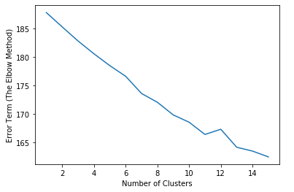
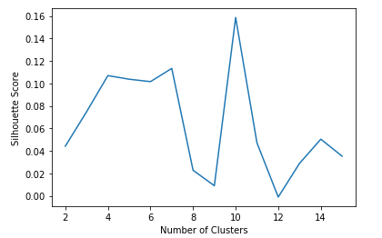
Results
Optimal number of clusters (K); K = 10 selected
Using elbow method and Silhouette score
The Elbow Method
The Silhouette Score Method

Slide 7
Results, cont’d
K = 10 Clusters of Bay Wheels Stations
Cluster | Number of Stations | Most Common Venue Types
1 | 21 | Park
2 | 334 | Coffee shop; yoga studio
3 | 4 | Art gallery; yoga studio
4 | 5 | Grocery store; yoga studio
5 | 5 | Gym; yoga studio
6 | 12 | Mexican restaurant
7 | 8 | Play ground; yoga studio
8 | 1 | Food & drink shop; yoga store
9 | 11 | Food truck; yoga studio
10 | 14 | Café; yoga studio

Slide 8
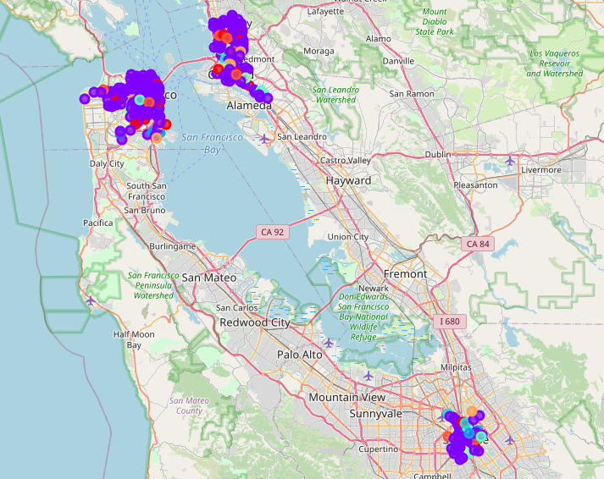
Results, cont’d
K = 10 Clusters of Bay Wheels Stations

Slide 9
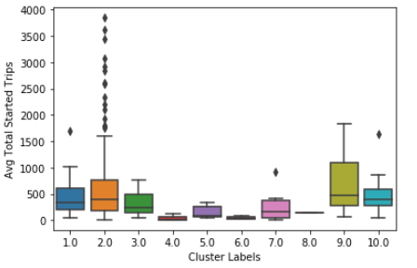
Results, cont’d
Trip Count Analysis:
Average monthly total started trips based on clusters
Outliers:
Clusters 1, 7, and 10
Only 1 outlier
Cluster 2:
334 stations in this cluster
Only 15 outliers

Slide 10
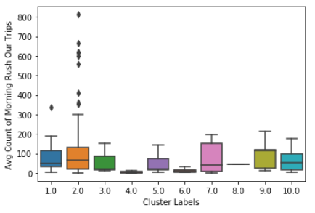
Results, cont’d
Trip Count Analysis:
Average monthly morning rush hour started trips based on clusters
Outliers:
Clusters 1
Only 1 outlier
Cluster 2:
334 stations in this cluster
Only 13 outliers

Slide 11
Conclusion
Bay Wheels bike-sharing stations clustered based on nearby venue types
Using Foursquare API
Optimal number of clusters
Error term (sum of distances between each station and its assigned cluster, i.e. sum of intra-cluster errors/distances
Silhouette score investigation
Analyze the trip counts data using publicly available anonymized trip logs
Average monthly total and morning rush hour started trips based on the clusters determined

Slide 12
Conclusion, cont’d
Analyzing trip counts based on clusters
Consistent observations with few outliers
Clusters can be used to reliably predict the average monthly total and morning rush hour started trips
Predictions can be used by decision makers and operators for planning as well as managerial practices
Station locating, rebalancing plan, etc.
Future directions:
Detailed insights through time series analysis
Researching clusters incorporating other attributes:
land use and land cost, and dominant user demographics, etc.

Slide 13
Thank You!

